Slide 1
MATLAB Basics （III）
施心慧
中国海洋大学数学院

Slide 2
Contents
Examples for plotting surfaces（曲面）
Plotting multi-graphs in one figure window（一窗多图）
Program Designing

Slide 3
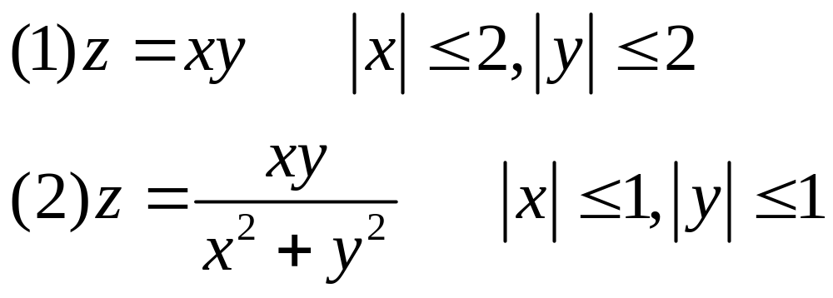
Examples for plotting surfaces
Plotting the following surfaces:

Slide 4
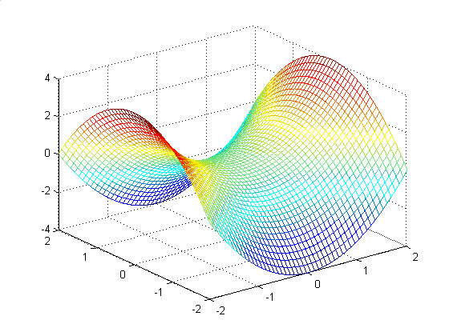
%---plot surface : z=x^2-y^2--------------
clear
x=linspace(-2,2,50);
y=x;
[X,Y]=meshgrid(x,y); %生成矩形网格结点上的横、纵坐标
Z=X.^2-Y.^2;
mesh(X,Y,Z)

Slide 5
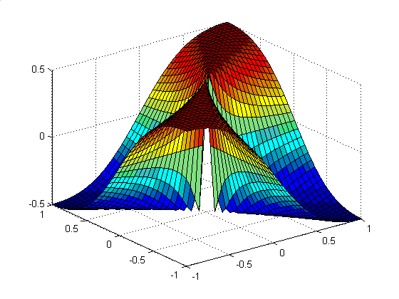
%---plot surface : z=x*y/(x^2+y^2)-------------- clear x=-1:0.05:1; y=x;
[X,Y]=meshgrid(x,y);
Z=(X.*Y)./(X.^2+Y.^2);
surf(X,Y,Z)

Slide 6
Plotting multi-graphs in one figure window
Basic Form:
subplot( m, n, 1);
plotting statements
subplot(m,n,2);
plotting statements
…
plotting statements:
plot, polar, contour
plot3,mesh,surf,contour3

Slide 7
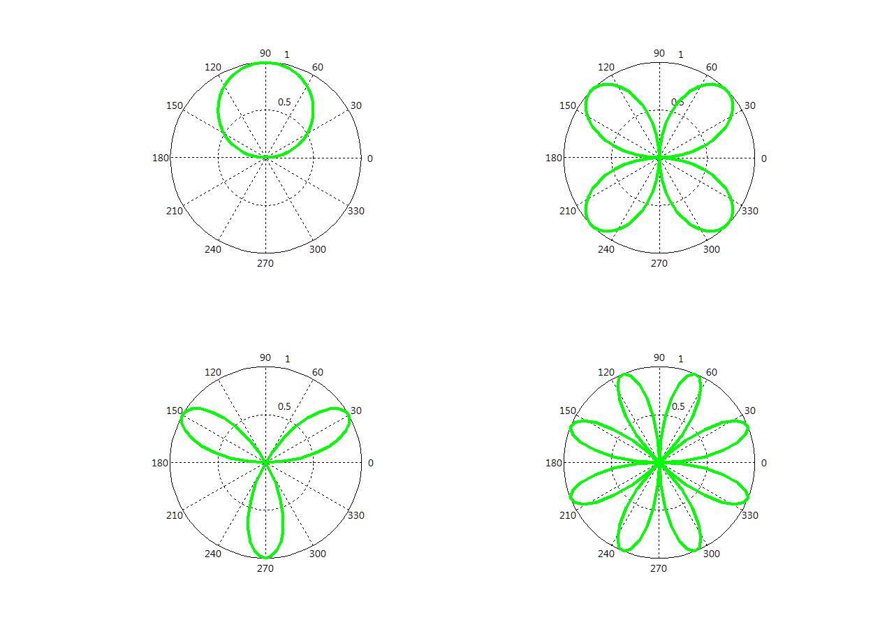
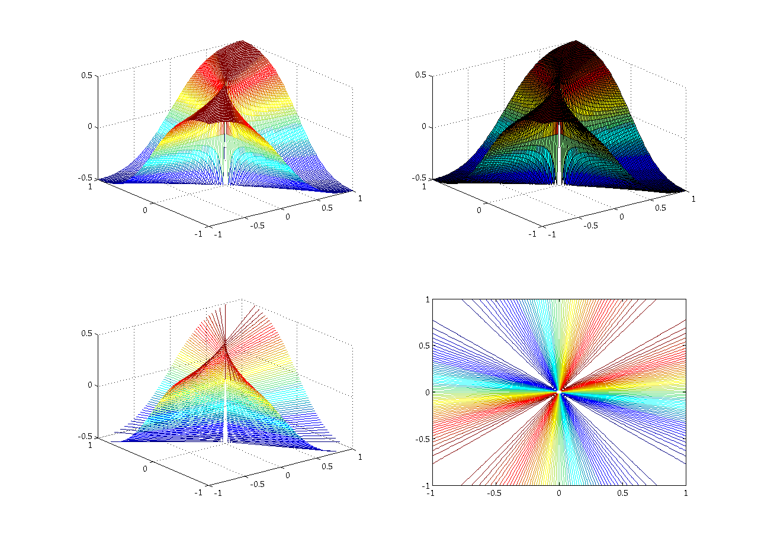

Slide 8
clear
t=linspace(0,2*pi,100);
a=2;
r1=a*sin(t);
r2=a*sin(2*t);
r3=a*sin(3*t);
r4=a*sin(4*t);
m=2;n=2;
subplot(m,n,1);polar(t,r1);
subplot(m,n,2);polar(t,r2);
subplot(m,n,3);polar(t,r3);
subplot(m,n,4);polar(t,r4);

Slide 9
Plotting surfaces
%-Plot surfaces--
clear
sp=0.02;a=1;
x=-a:sp:a;
y=x;
[X,Y]=meshgrid(x,y);
Z=(X.*Y)./(X.^2+Y.^2);
subplot(2,2,1);mesh(X,Y,Z)
subplot(2,2,2);surf(X,Y,Z)
subplot(2,2,3);contour3(X,Y,Z,60)
subplot(2,2,4);contour(X,Y,Z,60)

Slide 11
%----plot(x,z)----z is %--a matrix--
clear
x=linspace(0,2*pi,100);
y1=cos(x)*2;y2=cos(x)*3;
y3=cos(x)*4;y4=cos(x)*5;
z=[y1;y2;y3;y4];
% plot(x,y1,x,y2,x,y3,x,y4,'LineWidth',3)
% legend('2cosx','3cosx','4cosx','5cosx')
%-------------alternative approach--------
plot(x,z,'LineWidth',3)
legend('2cosx','3cosx','4cosx','5cosx')

Slide 12
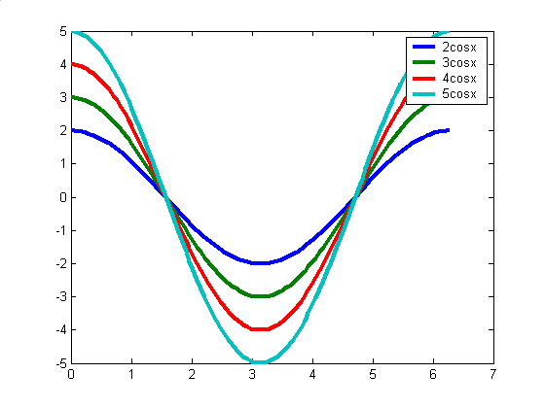

Slide 13
Programming
Relational and logical operators(关系与逻辑运算符)
Branches（分支结构）
Loops（循环结构）
M-file
function M-file
script（角本） M-file

Slide 14
Relational and logical operators
Relational operators:
> < >= <= == ~=
clear
a=1
x=-3:2:3
r1=a>0
r2=x>0
if x>0
disp('x>0')
else
disp('x<=0')
end
a =1
x = [-3 -1 1 3]
r1 =1
r2 =[ 0 0 1 1]
x<=0

Slide 15
Relational and logical operators
Relational operators:
> < >= <= == ~=
Logical operators:
&(and)
|(or)
~(not)

Slide 16
Branches statements
if construct
if condition
statements
end

Slide 17
Branches Statements
if construct
if condition1
statements 1
elseif condition2
statements 2
elseif condition 3
statements 3
…
else
statements n
end

Slide 18
Branches
switch construct
switch expression
case value 1
statements 1
case value 2
statements 2
…
otherwise
statements n
end

Slide 19
Example for Branches Statements
Input an integer from the keyboard, and output like this:
The integer can be divided by 6 or can not be divided by 6, the remainder is …

Slide 20
%--------Example for Branches Statements-----
x=input('Enter an integer x= ');
n=3;
y=mod(x,n);
if y==0
'The integer can be divided by 3'
else
disp('The integer can not be divided by 3 ')
disp('The reamainder is '),y
% 'The reamainder is ',y
end
Enter an integer x= 3
ans =
The integer can be divided by 3
Enter an integer x= 29
The integer can not be divided by 3
The reamainder is
y =
2

Slide 21
%--------Example for Branches Statements-----
%------using swith statement--------
x=input('Enter an integer x= ');
n=3;
y=mod(x,n);
switch y
case 0
'The integer can be divided by 3'
case 1
disp('The integer can not be divided by 3 ')
disp('The reamainder is 1')
case 2
disp('The integer can not be divided by 3 ')
disp('The reamainder is 2')
end

Slide 22
Loops（循环）
execute a sequence of statements more than once
for loop
while loop
Notes:
Loops are MATLAB constructs that permit us to execute a sequence of statements more than once

Slide 23
for statement
for loop_variable=initial_value:step:final_value
statements
end
%repeated a specified number of times.
Notes:
The code in a for loop is repeated at specified number of times, and the number of repetition is known before the loops starts

Slide 24
while statement
while condition
statements
end
% be repeated an
indefinite number of times
Notes:
The code in a while loop is repeated an indefinite number of times until some user-specified condition is satisfied

Slide 25
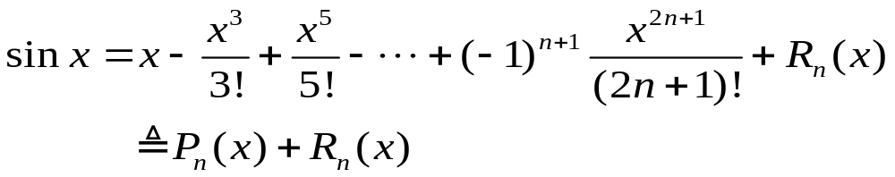
Exercises
2.Write a function y generate the uniformly distributed random numbers between 0 to 10.
3. Plotting a series of Pn(x) of sinx in the neibourhood of 0.

Slide 26
Exercises
4.Input an integer from the keyboard, and output like this:
The integer can be divided by 3 or can not be divided by 3, the remainder is …

Slide 27
break and continue statements
They are two additional statements that can be used to control the operation of while loops and for loops.
break statement terminates the execution of a loop and passes control to the next statement after the end of loop
Notes:
break statement stops the execution of a loop and transfers control to the first statement after the end of loop

Slide 28
break and continue statements
continue statement terminates the current pass through the loop and returns control to the top of the loop.
Notes:
continue statement stops the execution of the loop, and transfers control to the top of the loop for the next iteration.

Slide 29
break and continue statements
%Example 1
for i=1:5
if i==3
break;
end
fprintf(‘i = %d\n’,i);
end
disp(‘End of loop!’)

Slide 30
break and continue statements
Example 2
for i=1:5
if i==3
continue;
end
fprintf(‘i = %d\n’,i);
end
disp(‘End of loop!’)

Slide 31
Exercise
1. Fabonacci sequence:
Try to find the first term which is greater than 100.

Slide 32
%--------Example for while loop-----
%------using while statement--------
n=200;
a=ones(1,n);%-----initialize the vector a-------
k=2;
while a(k)<=100
a(k+1)=a(k)+a(k-1);
k=k+1;
end
disp(strcat('k=',num2str(k)))

Slide 33
%--------Example for For loop-----
%------using For and Break statement--------
n=200;
a=ones(1,n);%-----initialize the vector a-------
k=2;
for k=2:n
if a(k)<=100
a(k+1)=a(k)+a(k-1);
else
break
end
end
disp(strcat('k=',num2str(k)))

Slide 34
Displaying Output Data
The disp function accepts an array argument and displays the value of the array in the Command Window, without printing the name of the array.
If the array is of type of char, then the character contained in the array is printed out.
num2str: convert a number to a string

Slide 35
Formatted Output with the fprintf Function
The general form:
fprintf(format,data)
Format String | Results
%d | Display values as an integer.
%e | Display values in exponential format.
%f | Display values in floating point format.
%g | Display values in either floating point or exponential format.
\n | Skip to a new line.

Slide 36
Save and load data
‘save’ and ‘load’
save filename var1 var2 var3
the filename is the name of the file in which the variables are saved.
var1, var2 and so forth are the variables to be saved in the file.

Slide 37
Save and load data
By default, the file name will be given the extent ‘mat’ and such data files are called MAT-files.

Slide 38
MATLAB Function Files
Script file
MATLAB M-file
Function file

Slide 39
MATLAB Function Files
A MATLAB function is a special M-file that runs in its own independent workspace.
It receives input data through an input argument list, and returns results to the caller through an output argument list.

Slide 40
MATLAB Function Files
The general form of a MATLAB function:
function [outarg1,outarg2,…]=fname(inarg1,inarg2,…)
%H1 comment line
% Other comment lines
…
(Excecute code)
…
(return)
output argument list
input argument list

Slide 41
MATLAB Function Files
The function statement marks the beginning of the function.
It specifies the name of the function and the input and output argument lists.

Slide 42
MATLAB Function Files
The input argument list is a list of names representing values that will be passed from the caller to the function.
Similarly, the output argument list contains a list of dummy arguments that are placeholders for the value returned to the caller when the function finishes executing.
哑元

Slide 43
MATLAB Function Files
A function is invoked by naming it in an expression together with a list of actual arguments.
A function can be invoked by typing its name directly in the Command Window (the function should be under the current directory), or by including it in a script file or another function.

Slide 44
MATLAB Function Files
Execution begins at the top of the function, and ends then either a return statement or the end of the function is reached.
The return statement is not required in most functions, and it is rarely used.

Slide 45
MATLAB Function Files
Each item in the output argument list must appear on the left side of at least one assignment statement in the function.
When the function returns, the values stored in the output argument list are returned to the caller and can be used in further calculations.

Slide 46
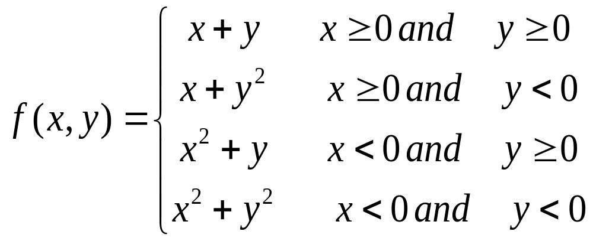
Exercises
5.Write a MATLAB program to define the function as follows:

